Slide 1
Hall Effect
Presented By
K. JAYADEV
Lecturer in Physics
P R Govt. College( A)
kakinada

Slide 2
HALL EFFECT
The Hall effect was discovered in 1879 by Edwin Herbert Hall while working on his doctoral degree at the Johns Hopkins University in Baltimore, Maryland, USA.
According to him “ When a Magnetic field is applied perpendicular to a current carrying conductor, a potential difference is developed between the points on opposite side of the conductor”

Slide 3
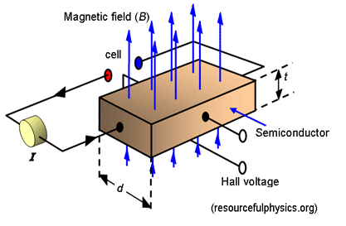
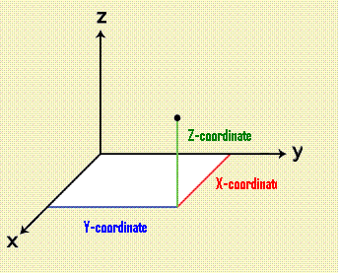
A static magnetic field has no effect on a charged particle unless it is moving.
When charges flow, a mutually perpendicular force (Lorentz force) is induced on the charge.
Now electrons and holes are separated by opposite force.

Slide 4
The direction of the force is given by Flemings Left Hand rule.
Lorentz force is the combination of electric and magnetic force on a point charge due to electromagnetic fields.
If a particle of charge q moves with velocity v in the presence of an electric field E and a magnetic field B, then it will experience a force F
F = qEH + q (VdxB)

Slide 5
When net force acting on Charge Carrier is Zero
qEH + q (Vd x B) = 0
EH = -(Vd x B) or In magnitude EH = -Vd B
The drift velocity Vd is related to current density j by Vd = - j / nq
Where n is the number of charge carriers in unit volume.
Hence EH = (1/nq) jB
Also if VH is the Hall Voltage, then EH = (VH/d)

Slide 6
The ratio of Hall Electric field EH and product of current density j and magnetic field B is Known as Hall Coefficient (RH).
RH = (EH / jB) = 1/nq
RH = 1/nq.
It is negative when the charge carriers are Electrons, and is positive when the charge carriers are holes.

Slide 7
Applications
i) It gives the information about the sign of the charge carrier
ii) We can understand the electrical conduction in metals & in Semi conductors.
Iii) We can also measure the drift velocity Vd of the charge carriers.
iv) We can know the number of charge carriers per unit volume n by measuring the Hall Coefficient

